Slide 1
MyAccessID governance and roadmap in GN5-2
Alex Stuart, Trust & Identity technical architect
MyAccessID Online Workshop, 2 December 2025

Slide 2
Governance

Slide 3
Size of federations in eduGAIN
Notes:
One member one vote
UK federation has helpdesk with much experience (Deepak in presentation; Martin in chat)
eduGAIN declaration is that it does not supplant any federation’s own rules

Slide 4
Governance of GN5-2 WP5 services
GÉANT Assembly & Board
GÉANT Project Planning Committee
GÉANT Project GN5-2
Work Package 5: Trust & Identity
eduroam
eduGAIN
MyAccessID
100 countries / territories
8.4B authentications/year
Global governance: 3 people from each of 5 regions + 4 non-voting experts
83 participating federations
10K connected IdPs/SPs
27M user accounts
Global governance: - Executive Committee - Steering Committee (6 elected + 3 ex officio) - eduGAIN Assembly
1258 connected IdPs
650K user accounts
Engages with stakeholders (NRENs, research infrastructures) to support collection of new use cases, requirements gathering, analysis and design
Notes:
1. Funding streams EC project funding + cost sharing among GÉANT member organisations
2. History
Eduroam 2003-
eduGAIN 2014-
MyAccessID 2022 or thereabouts (CoreAAI is MyAccessID, MyAcademicID, eduTeams)
3. MyAccessID engagement
V low volume mailing list
monthly meetings
CTO workshops … fed back that comms poor
Can also note governance of T&I incubator (open proposals / selection from TL+WPL) and InAcademia (Commercial)

Slide 5
Some timescales (strategic and tactical)
 | Start | End
GÉANT project GN5-2 | January 2025 | June 2027
GÉANT project GN5-3 | July 2027 | December 2028
Internet2 Technology Exchange / FIM4R | December 2025
TIIME unconference | February 2026
TNC26 | June 2026
UK NCSC: Build initial migration plan for PQC | May 2025 | December 2027
EU NIS CG: Complete first steps of PQC transition | June 2025 | December 2026

Slide 6
Roadmap

Slide 7
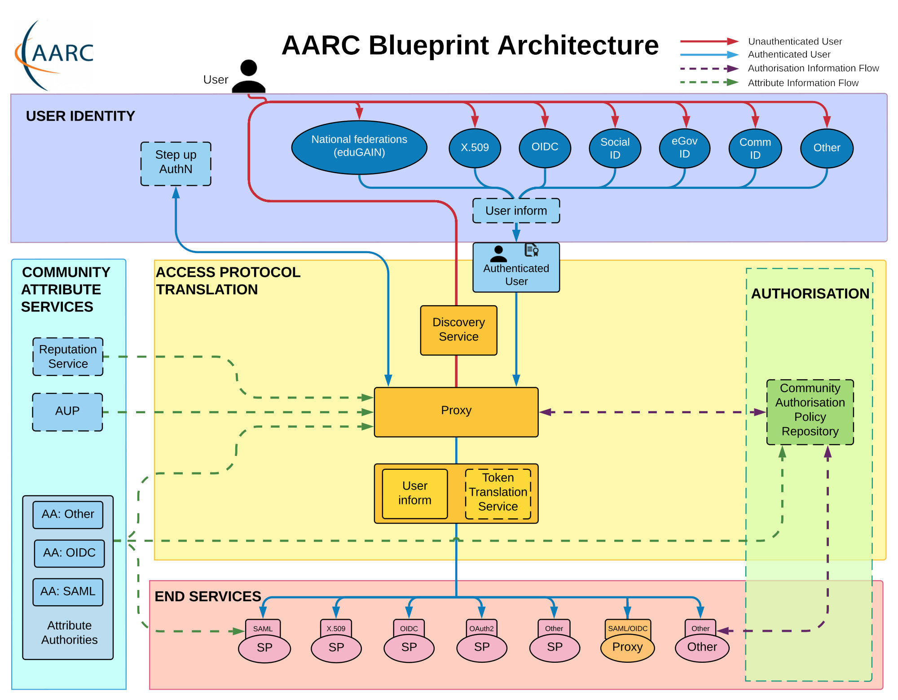
Notes:
Architecture … no off the shelf software? Comparable with Christopher’s slide with
Discovery service lets people choose their home IdP, it’s good to have a logo for UX.
Some things missing: identity matcher, accountability?

Slide 8
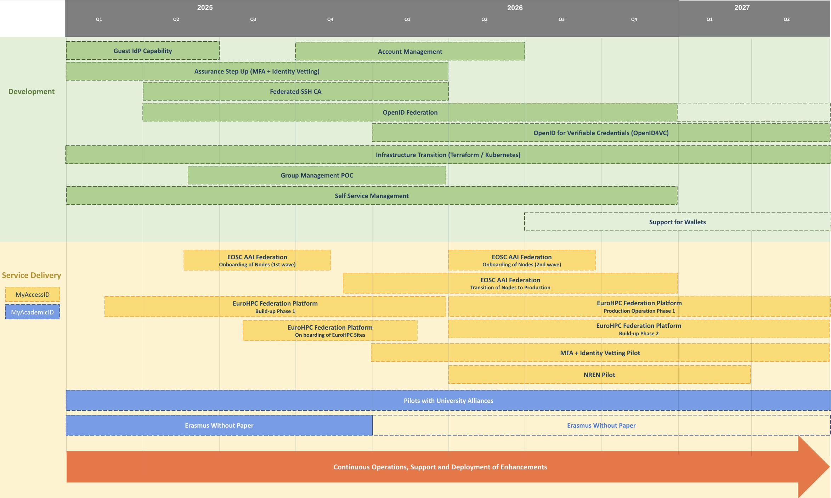
Roadmap of CoreAAI (MyAccessID and MyAcademicID)

Slide 9
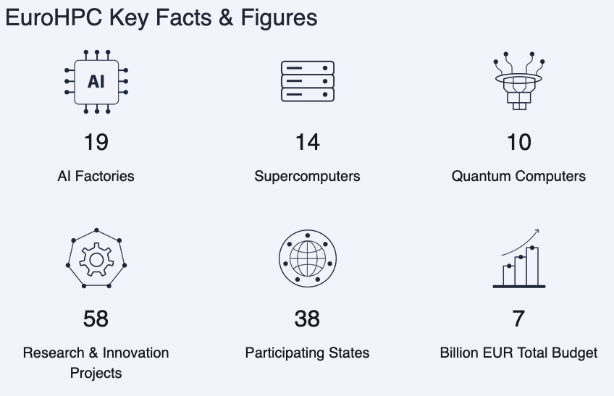

Some numbers for MyAccessID connected services
EuroHPC
EOSC nodes in buildup phase
MyAccessID connected services: https://wiki.geant.org/spaces/MyAccessID/pages/292978896/Connected+Services

Slide 10
Contact details
Alex Stuart
Trust & Identity technical architect
alex.stuart@jisc.ac.uk
trustandidentity@jisc.ac.uk

